Slide 1
Migrate Your SSIS Skills to Azure Data Factory
Koen Verbeeck
He/Him
Senior Consultant
AE

Slide 2

Koen
Verbeeck
Senior Consultant
From Belgium (chocolate, fries and beer)
Microsoft Data Platform MVP for 6 years
Avid Batman comic reader
Hates pie charts
AE
LinkedIn
Twitter
Blog

Slide 3
agenda
How do I transfer my skills from SSIS to ADF?

Slide 4
you have 3 options
“Lift&shift” existing SSIS projects to ADF
Start creating pipelines in ADF
Use data flows as well

Slide 5
lift & shift

Slide 6




provisioning & management
Azure-SSIS IR (Azure Compute)
SSISDB
Azure SQL DB or Managed Instance
ADF
Cloud
On-premises
SSISDB
author & deploy
manage & schedule
SSDT
SSMS

Slide 7

provisioning & management
Azure-SSIS IR (Azure Compute)
Azure Files
ADF
Cloud
On-premises
author & deploy
manage & schedule
SSDT
SSMS

Slide 8
Azure-SSIS IR
one of three Integration Runtimes
Azure IR – data movement & activity dispatch
Self-hosted IR – data management gateway
Azure-SSIS IR – lift & shift of SSIS projects
“SSIS scale-out cluster on VMs in the cloud”

Slide 9
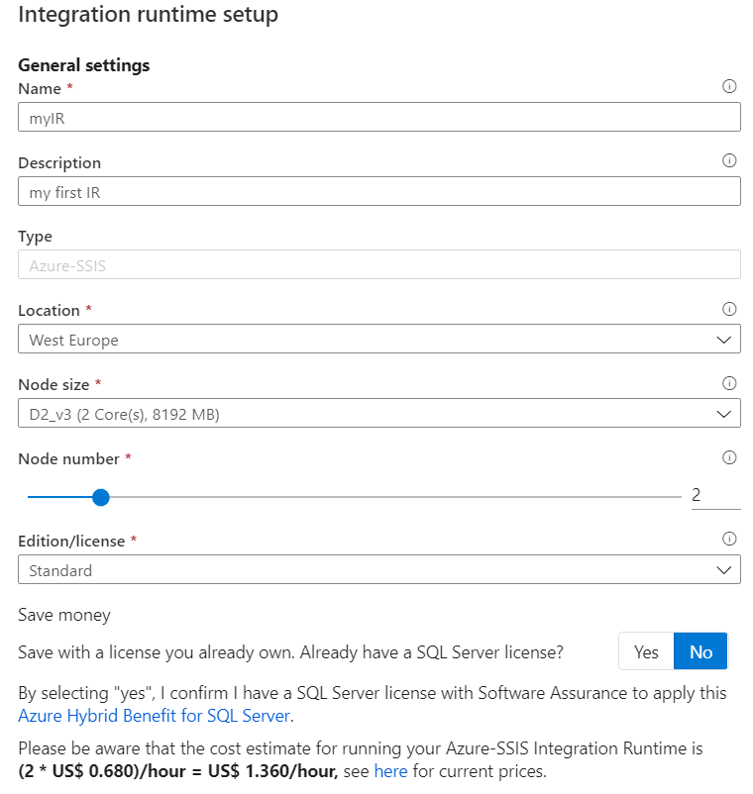

Slide 10
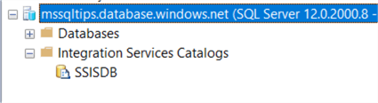
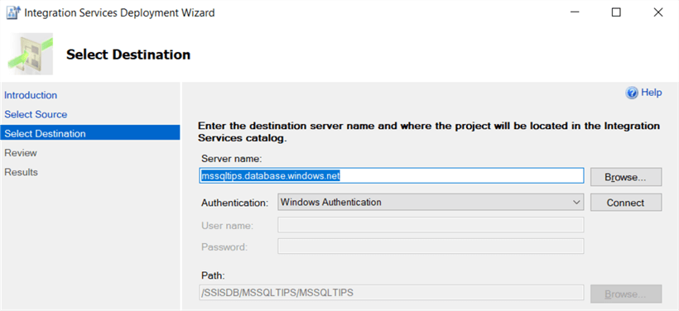

Slide 11
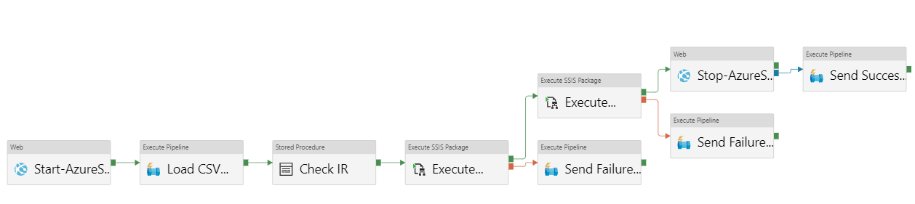
typical flow
automatically start/stop IR
do non-SSIS stuff while IR is starting
coffee time!
run SSIS packages

Slide 12
demo

Slide 13
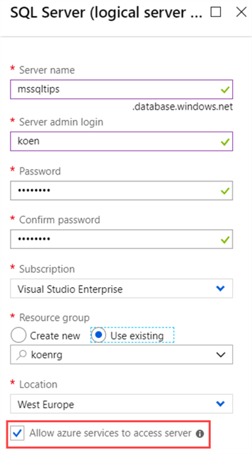
Step 1
Choose location of the SSISDB
Notes:
Azure SQL DB, managed instance or Azure Files

Slide 14
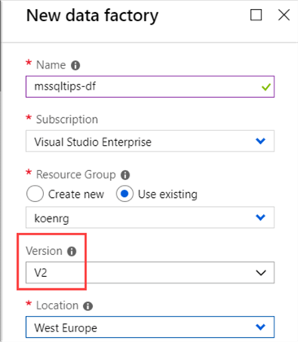
Step 2
Add some PowerShell cmdlets to your machine and create an ADF v2 instance

Slide 15
Step 3
Choose the Azure-SSIS node size

Slide 16
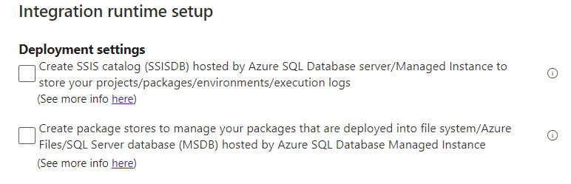
Step 4
Choose where to store your packages

Slide 17
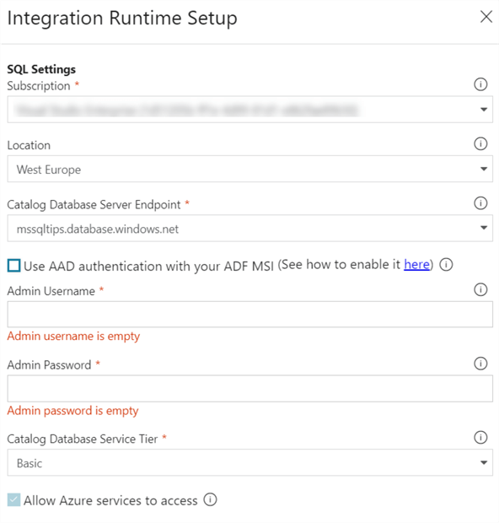
Step 5
Configure connection to SQL Server

Slide 18
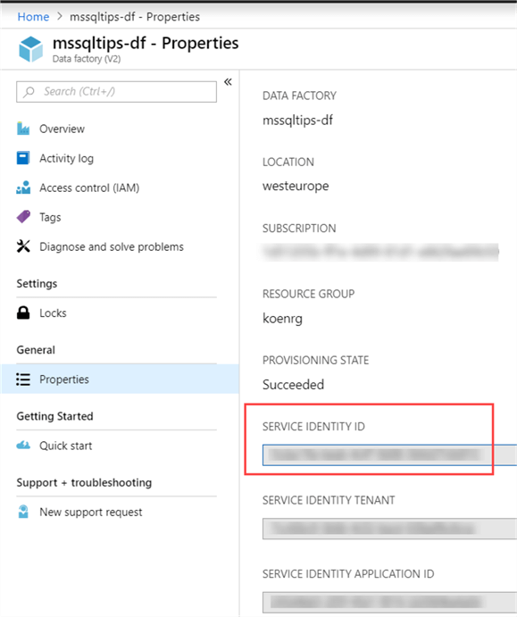
Step 6
If necessary, set up AAD authentication
CREATE USER [SSISIrGroup]
FROM EXTERNAL PROVIDER;
ALTER ROLE dbmanager ADD MEMBER [SSISIrGroup];

Slide 19
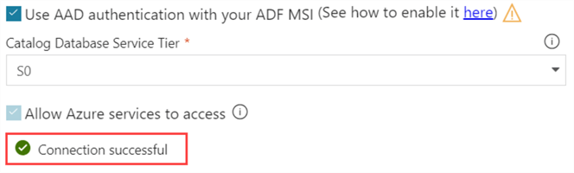
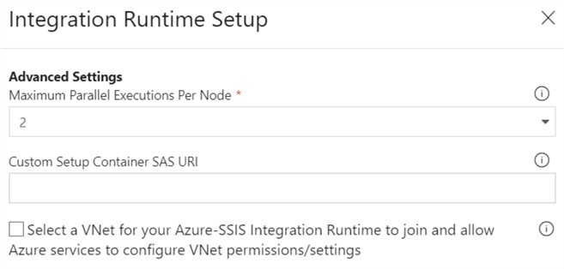
Step 7
Test connection and set number of parallel executions

Slide 20

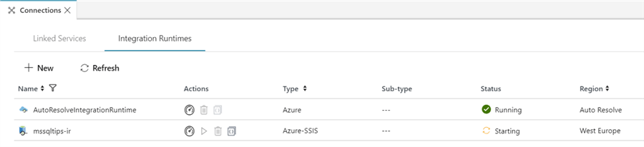
Step 8
Go grab some coffee

Slide 21
Step 9
Deploy your SSIS project to the SSIS catalog

Slide 22
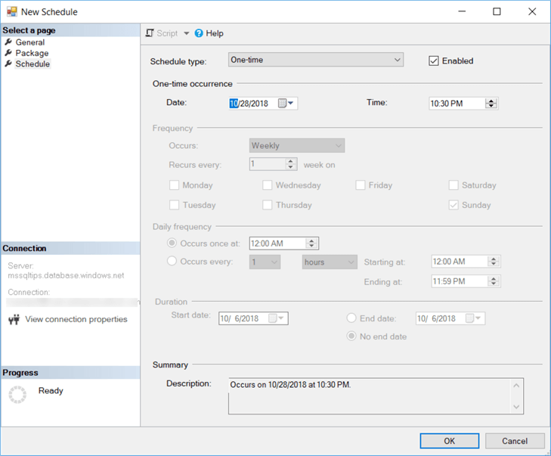
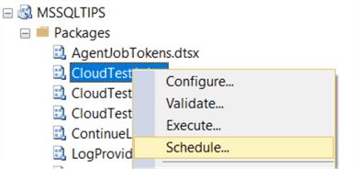
Step 10
Schedule your SSIS packages

Slide 23
want to learn more?
On-demand webinar at MSSQLTips.com

Slide 24
creating pipelines in ADF

Slide 25
A fully managed, serverless data integration service. Visually integrate data sources with more than 90 built-in connectors at no added cost. Easily construct ETL and ELT processes code-free in an intuitive environment or write your own code.

Slide 26
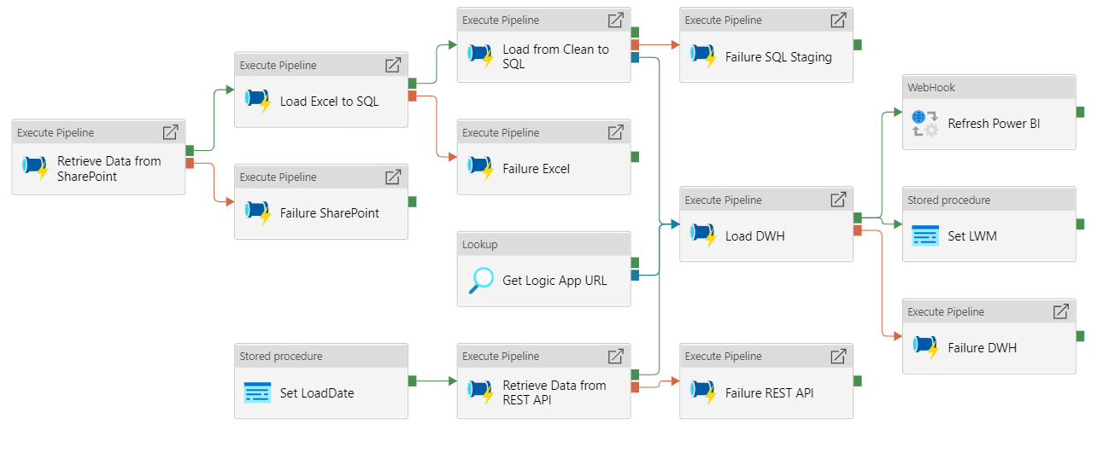
pipeline = control flow

Slide 27
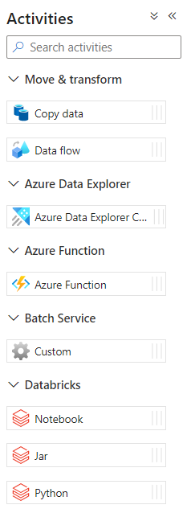
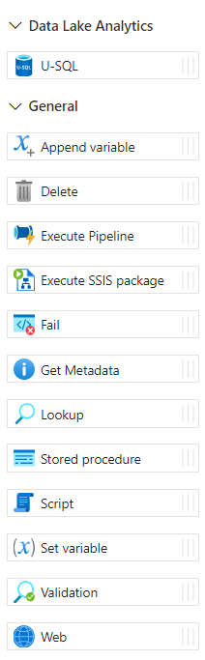
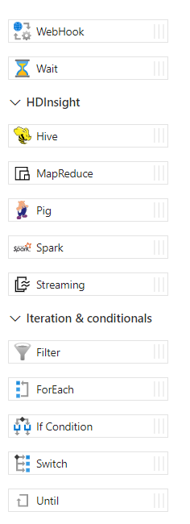
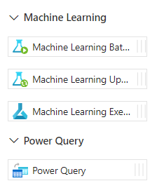
activities = control flow tasks

Slide 28

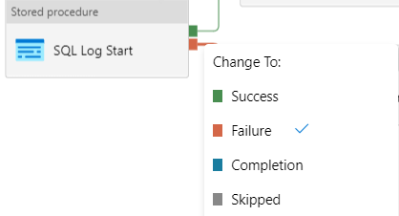
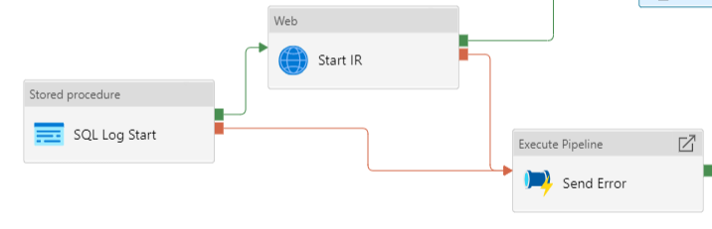
precedence constraints?

Slide 29
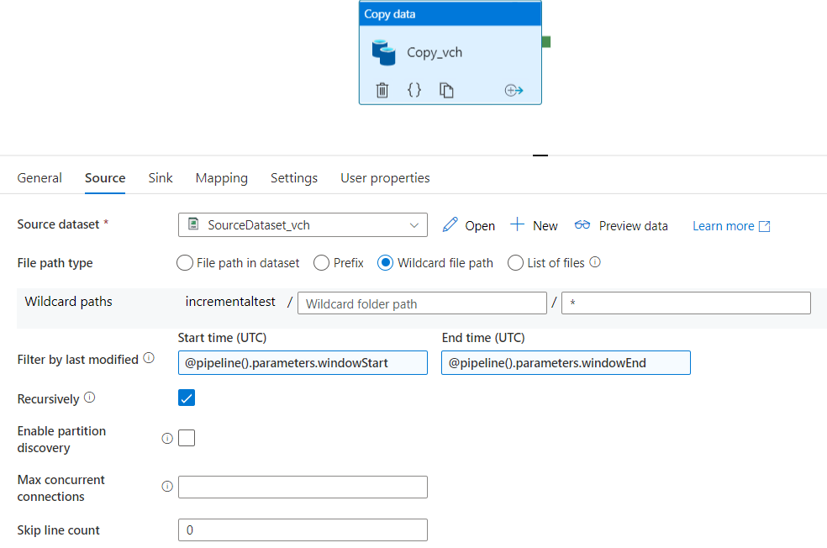
copy data activity = data flow with only source and destination

Slide 30
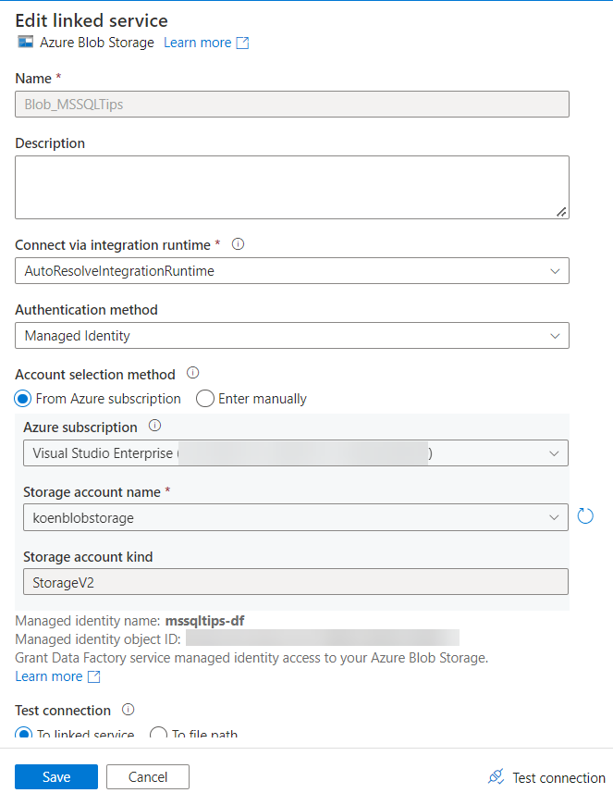
linked service = connection manager
points to a certain data location
contains info on how to authenticate
can integrate with Azure Key Vault

Slide 31
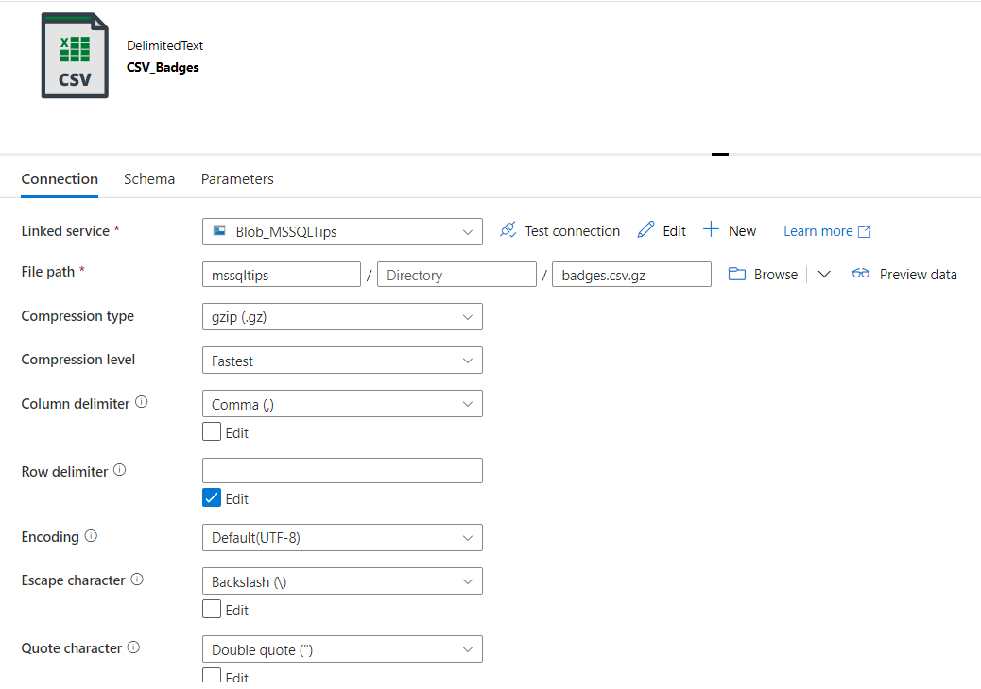
data set

Slide 32
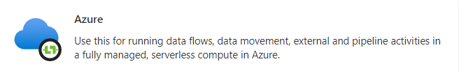
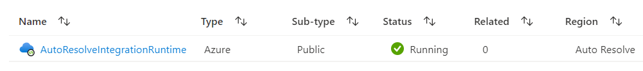


integration runtimes

Slide 33
demo

Slide 34
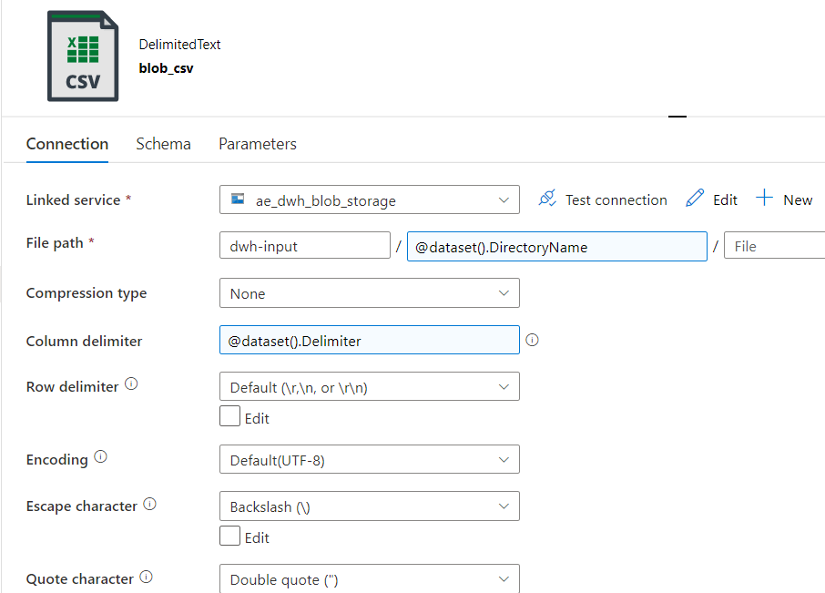
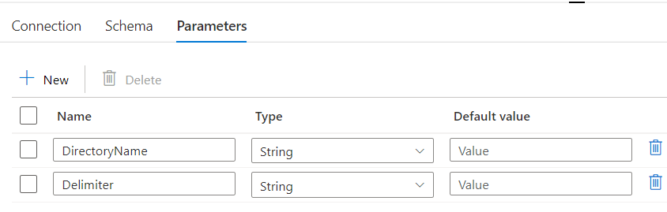
metadata ftw = forget about BIML

Slide 35
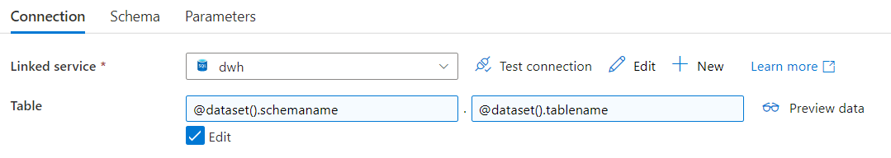
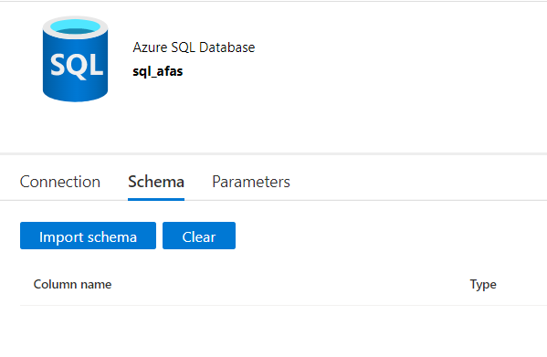
parameterize everything

Slide 36
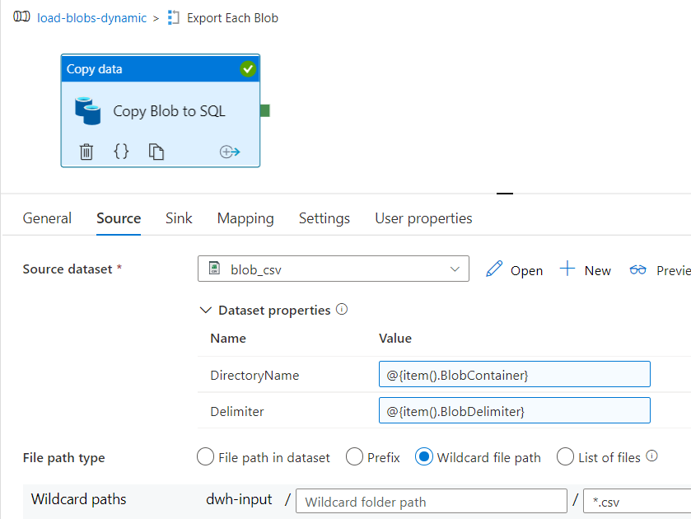
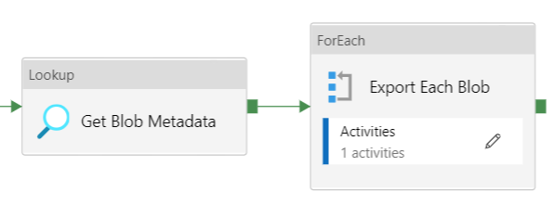
fetch metadata & loop

Slide 37
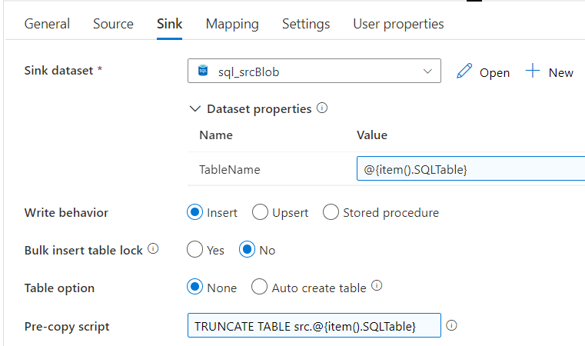
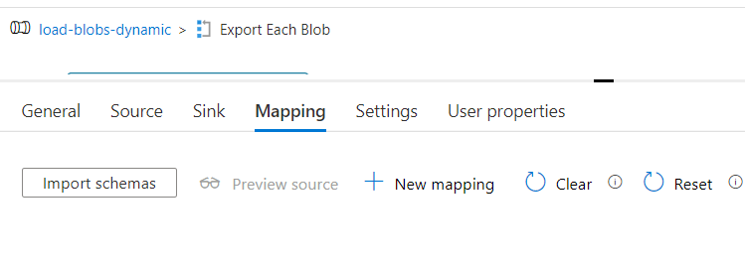
fill parameters at runtime
no need for mapping in simple use cases
use dynamic content

Slide 38
demo

Slide 39
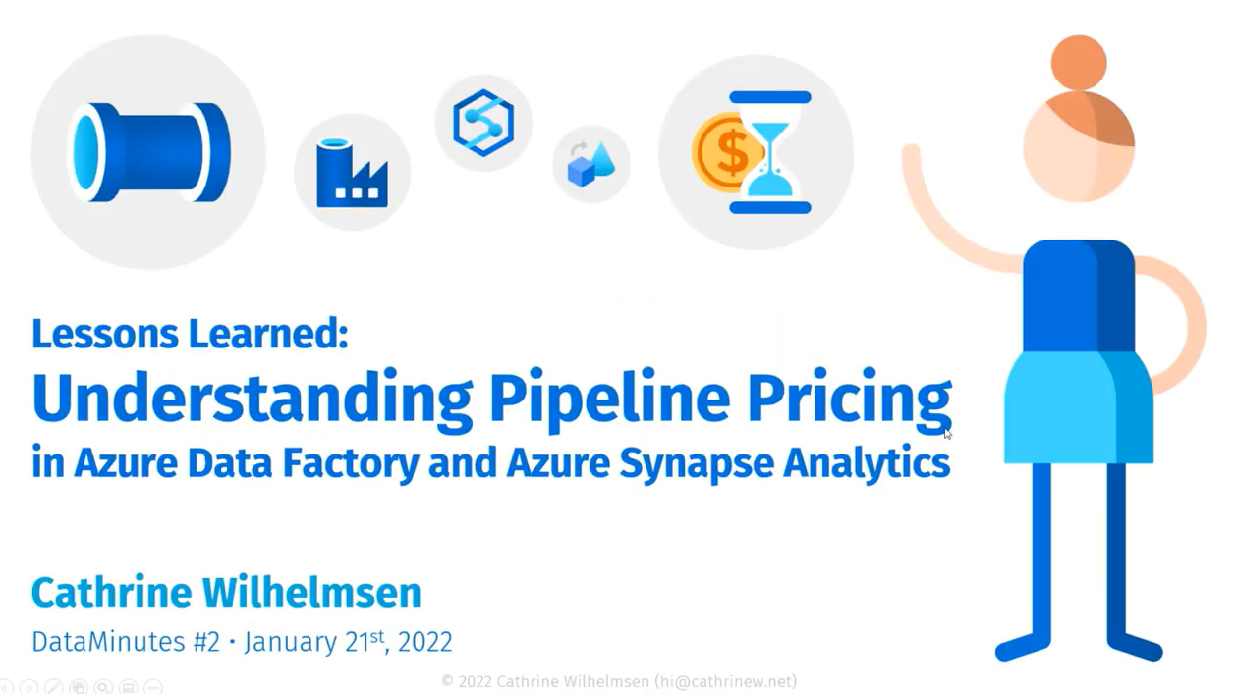
cost
https://youtube.com/watch?v=Fct1dcZMyWs

Slide 40
important to remember
ALL ACTIVITIES ARE PRO-RATED BY THE MINUTE
AND ROUNDED UP

Slide 41
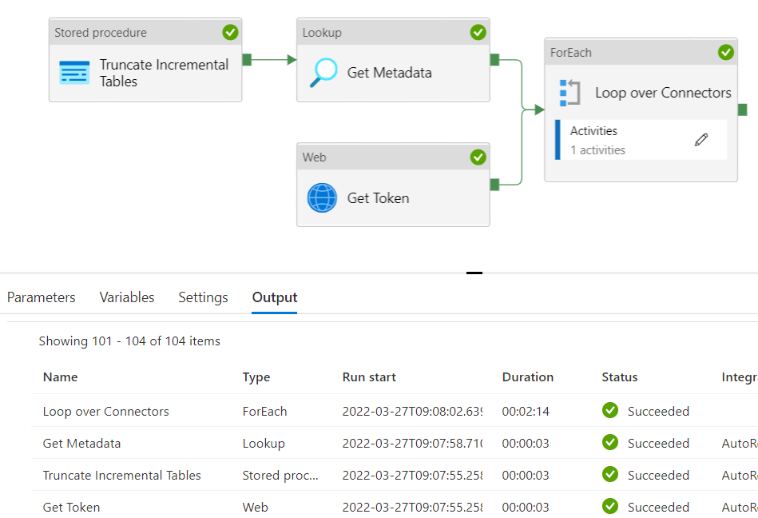
example
2 minutes and 23 seconds runtime

Slide 42
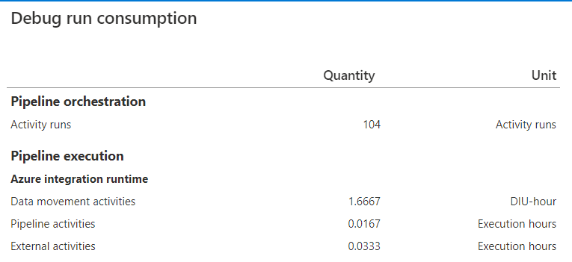
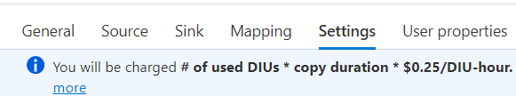
example
Orchestration (Azure-IR): $0.001/run
Pipeline (Azure-IR): $0.005/hour
$0,0000835/run
External (Azure-IR): $0.00025/hour
$0,000008325/run
Data Movement (Azure-IR): $0,25/hour
→ 2 * 1.6667 * $0.25 = $0,83335/run
$0,834441825 / run
once every day: $25.03
once every hour: $600.80
once every 5 min: $7209.58
1 minute
100 minutes!
2 minutes

Slide 43
using data flows

Slide 44
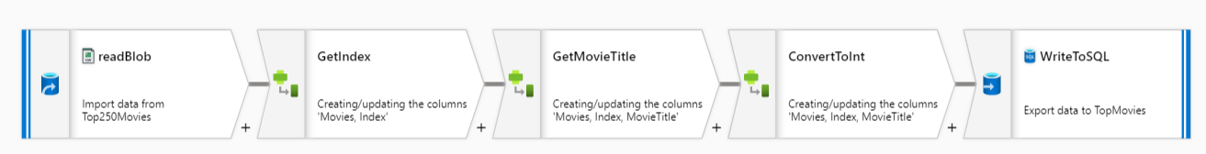
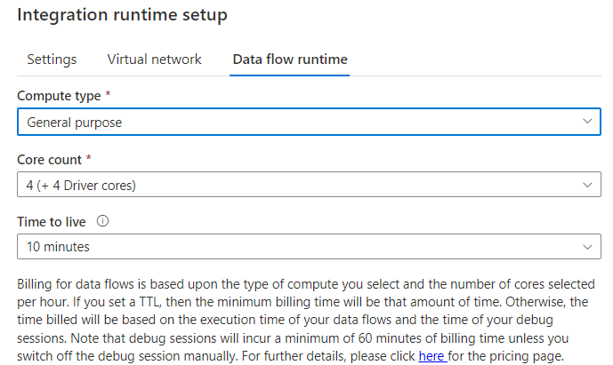
(mapping) data flow = SSIS data flow

Slide 45
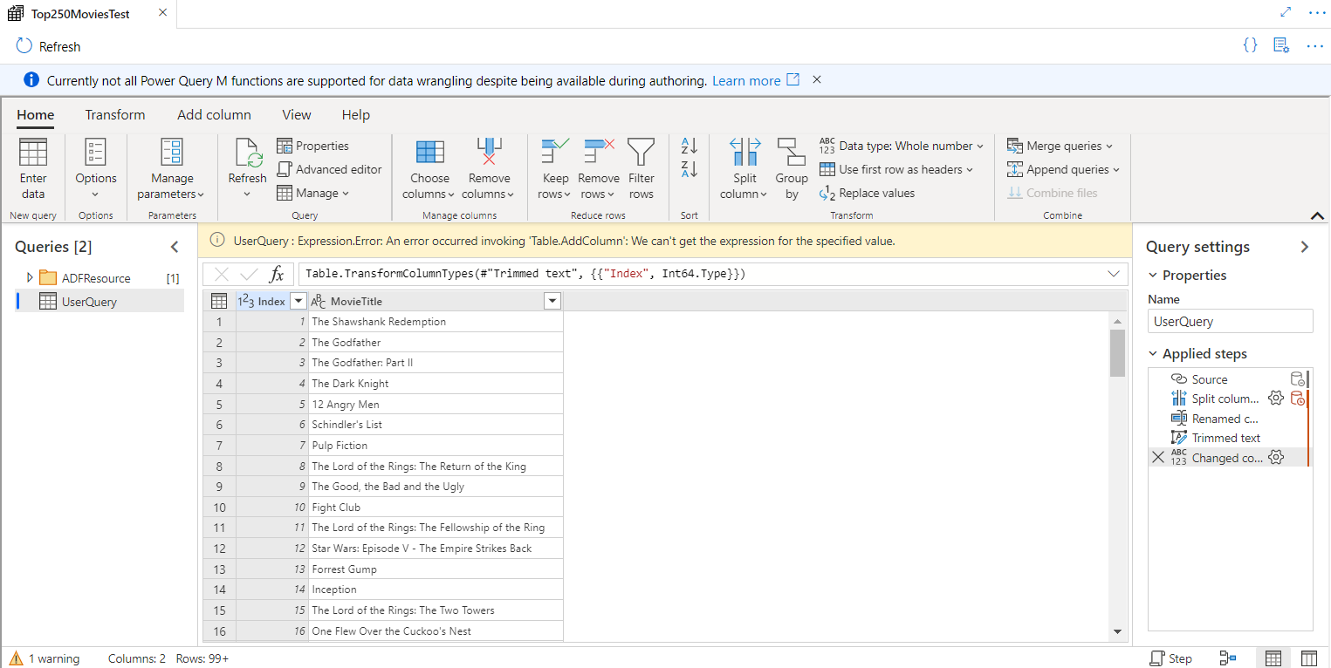
Power Query

Slide 46
demo

Slide 47
advantages of SSIS
mature ETL/ELT tool
easily extensible with .NET
you can create your own components
costs are paid up front (server + licensing)
it doesn’t matter how often you run a package
or how many tasks are in a package

Slide 48
advantages of ADF
cloud scale
no upfront investment
metadata-driven
choice of runtime
git integration

Slide 49
disadvantages of ADF
harder to debug
no option to disable activities
can’t run a single activity
cost can be brutal
still lacks functionality
send an email?
solve with Logic Apps or Azure Functions

Slide 50
want to learn more?
Dynamic Datasets in Azure Data Factory
Dynamically Map JSON to SQL in Azure Data Factory
Beginner's Guide to Azure Data Factory
Intro to ADF tutorial
Lots of conferences have recordings online

Slide 52
Come to the online Q&A if you have questions!
Koen Verbeeck
LinkedIn
Twitter
Blog

